Slide 1

DEVELOP A BUSINESS PLAN FOR A SMALL BUSINESS
Unit Standard 117241
NQF Level 4 Credits 5

Slide 2
INTRODUCTION
Company Introduction
Moripe Holdings is an enterprise development service provider which delivers accredited broad range of solutions.
Operational since 2003,
Accredited with:
Service Seta
TETA
ETDP
MICT
Facilitator Details
- Name: Sue
- Surname: Nkwanyana-Uzo

Slide 3

ROAD MAP
Business Plan Fundamentals
Setting Goals and Objectives
Analyse Competitive Positioning
Define Business Goal
  Vision & Mission Statements
The Management and Organisation of a Business
  The Business Structure
  Management Roles and Responsibilities
The Products or Services Offerings
Operational Plan
Marketing and Sales

Slide 4

Continuation…
Business Plan Structure
Front Page Of Business Plan
Financial Analysis
Banking
  List of Banks in South Africa
Safety Requirements
Insurance for Business

Slide 5

Continuation…
Table Of Content
Business Overview
Products/Services
Market Analysis & Strategy
Competition
Marketing Strategy
Business Structure and Management
Finances
Action Plan
Appendices

Slide 6

BUSINESS PLAN FUNDAMENTALS

Slide 7

WHAT IS A BUSINESS PLAN?

Slide 8
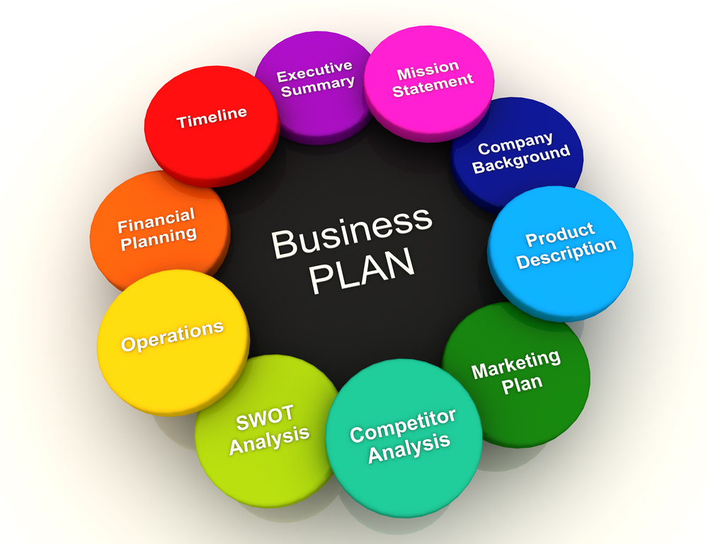

Slide 9
WHAT is a BUSINESS PLAN
A business plan is a written document describing a company's core business activities, objectives, and how it plans to achieve its goals.
A business plan is an essential written document that provides a description and overview of your company's future.
The plan is what explains your business strategy and your key goals to get from where you are now to where you want to be in the future
A business plan lays out a written roadmap for the firm from marketing, financial, and operational standpoints.

Slide 10
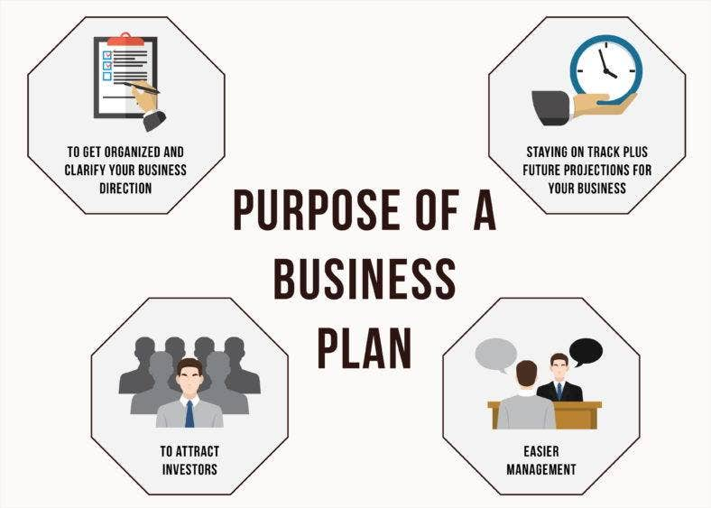
PURPOSE OF A BUSINESS PLAN
It is to create an effective strategy for growth
To establish business milestones
To better understand your competition
To better understand your customer
To attract the right team
To determine future financial needs (It forms part of a key component for raising funds)
To attract investors and lenders
It is road map for your business
It helps with the proper allocation of resources
It helps address future challenges and opportunities
The business plan articulates specific goals and objectives
It guides the implementation of capacity building strategies
It establishes performance guidelines and promotes efficiency

Slide 11
SETTING GOALS AND OBJECTIVES

Slide 12
BUSINESS GOALS
Taking the time to set goals for your business will assist you to greatly increase your ability to achieve them all.
Goals represent the organisations larger purpose. They usually don’t have to be specific with clearly defined actions.
Business goals are broad outcomes that the company wishes to achieve.
Business goals are a predetermined target that a business plans to achieve in a set period of time.
Goals give a business direction and help measure results.
Business goals are the “what’s”, not “how’s” of the business
Business might have multiple goals to achieve.

Slide 13
BUSINESS OBJECTIVES
While business goals describe where the company wants to end up, objectives dictate the directions for getting there.
A business objective is a measurable step taken to achieve a goal.
Goals are general while objectives are specific.
Business objectives act as a compass for the company; they track and analyse growth.

Slide 14
VISION & MISSION STATEMENTS
A Vision Statement describes the desired future position of the company, whilst A Mission Statement defines the company's business, its objectives and its approach to reach those objectives.
A vision statement is a written document that describes where an organization is going and what it will look like when it gets there.
A mission statement is a brief description of a company's fundamental purpose. A mission statement answers the question, "Why do we exist?”
The mission statement articulates the company's purpose both for those in the organization and for the public.
A vision statement is that inspirational statement of an idealistic emotional future of the organisation.
The Business Vision document captures very high-level objectives of a business modelling effort.
It communicates the fundamental "whys and what’s" related to the project and is a gauge against which all future decisions should be validate

Slide 15
ANALYSE COMPETITIVE POSITIONING
The goal of your competitor analysis is to identify and expand upon your competitive advantage - the benefits that your proposed business can offer the customer or client that your competition can't or won't supply
Competitive positioning is a strategy that refers to how a marketing team can differentiate a company from its competitors by applying the (SWOT) Analysis.
The goal of competitive positioning is to increase sales by improving the products / services value and level of customer satisfaction.
Competitive analysis is an integral part of every businesses’ marketing plan.
The main objective of a competitive analysis is to understand the company’s competitors and to think like them so that when creating a strategy, it will be partly based on the competitor’s possible actions.

Slide 16
SWOT ANALYSIS
A SWOT analysis is a strategic planning tool to shape the current and future operations of the organization.
It is to develop strategic goals.
It is to identify factors that impact a company's functioning and offer useful information during the strategic planning process.
Assist in making informed decisions
SWOT is an acronym for Strengths, Weaknesses, Opportunities, and Threats.
Simple rules for successful SWOT analysis:
Be realistic about the strengths and weaknesses of the organization
SWOT analysis distinguishes between where the organization is today vs the future.
SWOT should always be specific. Avoid grey areas.
Apply SWOT in relation to your competition
SWOT should be short and simple - avoid complexity and over analysis
SWOT is subjective.

Slide 17
GUIDELINES TO WRITE BUSINESS GOALS
Step 1
Review the five rules for setting business goals. In order to be effective, business goals must be specific, measurable, attainable, relevant and timely - SMART
Step 2
Be specific. This means identifying a situation or a goal that can be easily understood. The best goals are linked to numbers, ratios or percentages. The more precise managers can be about the need, the better the goal.
Step 3
Formulate measurable goals. In order to improve anything, you must first be able to measure it. Set up a system to measure how goals will be monitored, measured and recorded.
Step 4
Make each goal attainable. Another word for attainable is achievable. Setting goals beyond the competition may help to rally your team, but if the goal is unattainable, it will not work. This could have a negative effect on reaching your goals. Analyse the capabilities, strengths and weaknesses of your team before writing your goals.

Slide 18
Cont…
Step 5
Write relevant goals. Most organizations are made of different functional areas. Writing the most effective goals means making those goals relevant to everyone in the organization. Each group must understand how that goal pertains to their work duties and responsibilities.
Step 6
Be timely. Give each of your goals a time limit.
Overall
Identify your company's short-term business goals for a set period of time. ...
Break down each goal into actionable business objectives. ...
Ensure you objectives are measurable. ...
Assign goal-related tasks to employees. ...
Measure progress regularly

Slide 19
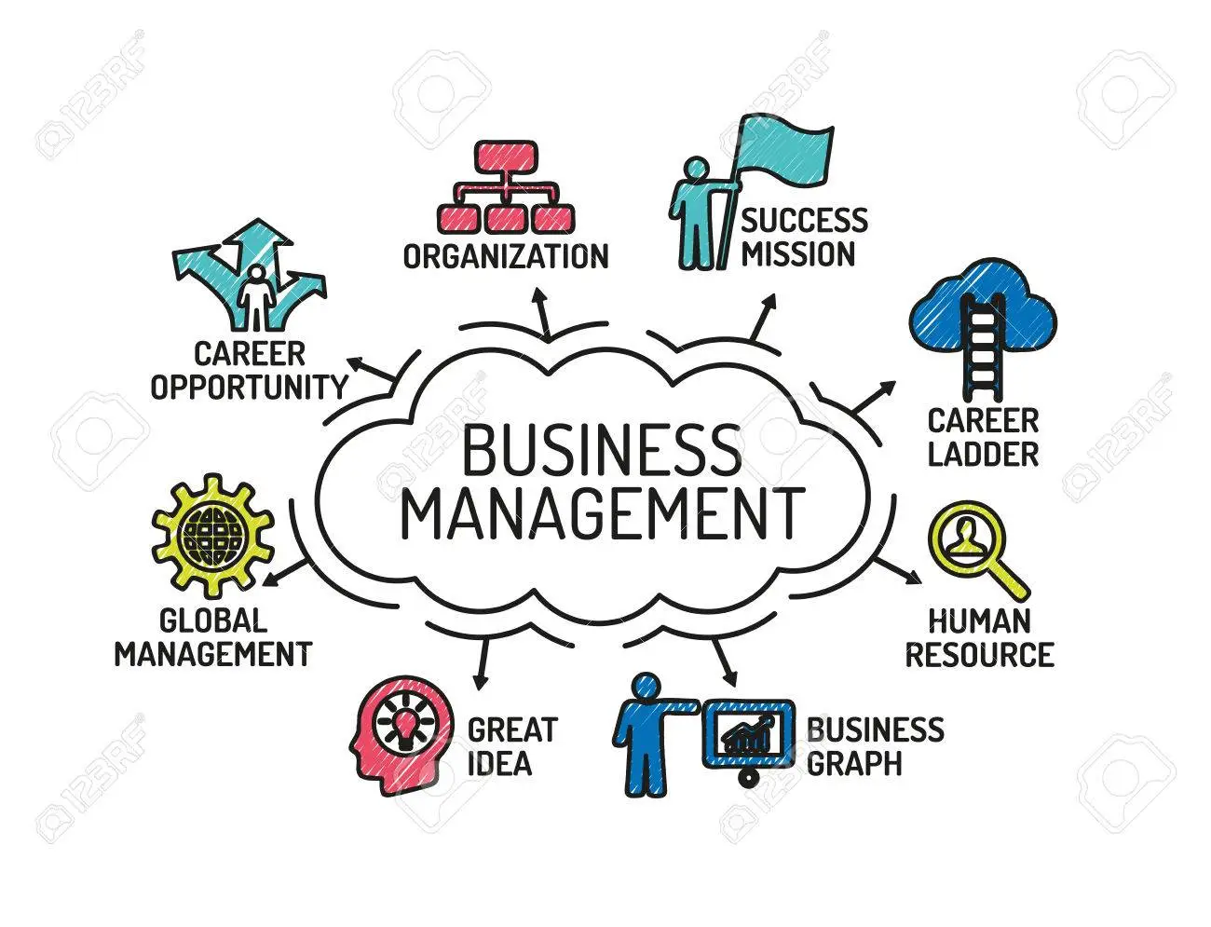
THE MANAGEMENT AND ORGANISATION OF A BUSINESS
The organization and management section of your business plan should summarize information about your business' structure and team. It usually comes after the market analysis section in a business plan
Organisations are structured in a variety of ways, dependant on their objectives and culture.
The structure of an organisation will determine the manner in which it operates and it’s performance.
Structure allows the responsibilities for different functions and processes to be clearly allocated to different departments and employees.
The wrong organisation structure will hinder the success of the business.

Slide 20
THE BUSINESS STRUCTURE
A business structure describes the legal structure of a company that influences the day-to-day operations of a business. A sole proprietorship and partnership are simple to set up since they are not required to meet ongoing requirements such as shareholder meetings and voting.
An organizational structure defines how activities such as task allocation, coordination, and supervision are directed toward the achievement of organizational aims. Organizational structure affects organizational action and provides the foundation on which standard operating procedures and routines rest
Business structure, processes design and job design are key areas for success in strategy implementation.
The organisational structure must reflect strategy, work flows (processes) must channel effort to strategic outcomes and jobs must reflect the essence of what is being aimed for.

Slide 21
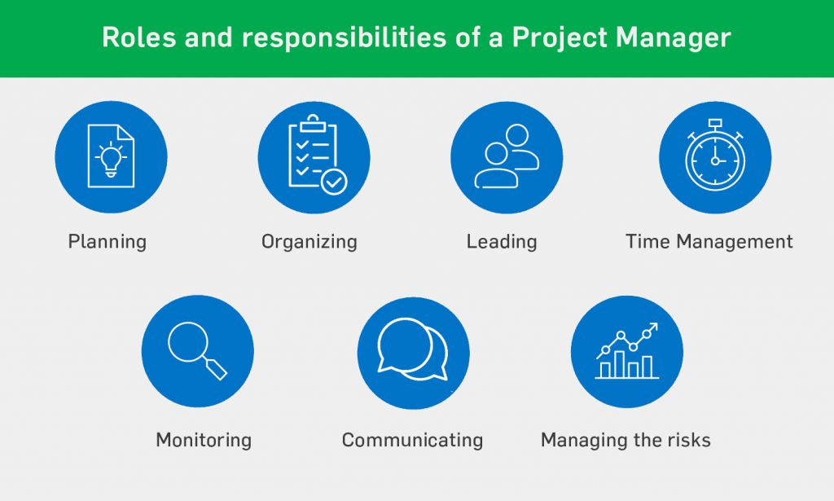
MANAGEMENT ROLES AND RESPONSIBILITIES
The primary functions of managers are planning, organizing, leading, and controlling.
Managers shape the culture of their teams and workplaces. They usually play both an administrative and leadership role and they require a diverse set of skills to be successful.
Job analysis is the process of getting detailed information about jobs
Job analysis helps with work flow analysis by helping to identify two things, namely the: processes necessary to achieve the outputs.

Slide 22
THE PRODUCTS OR SERVICES OFFERINGS
The products and services section of the business plan should include: A description of your offering. It needs to showcase the quality, value and benefits of your business offers, describing how the company's products and services differ/will from the competition.
In this section, you explain the concept for your business, along with all aspects of purchasing, manufacturing, packaging and distribution. As you write, avoid being too technical, assuming too much knowledge from your readers, and using buzzwords
Offerings are products and services designed to deliver value to customers—either to fulfil their needs, satisfy their “wants,” or both…

Slide 23
Continuation…
Stages of development: It is important to focus on the stage of development of the product or service, including how the company’s offerings - both product and services - have evolved to their present state and how they are going to evolve in the future.
Competitive comparison: How is your product competitive with other similar products? Will save time? Is there a competitive advantage in production?
Sales literature/Sourcing/Technology: Include any pertinent information that directly relates to the description of the product or service.

Slide 24
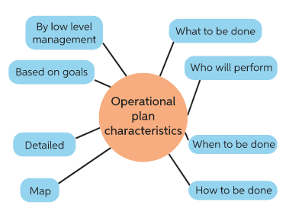
OPERATIONAL PLAN
The operational plan is an essential component to your business plan and it tells the reviewer how you are going to get your product/service out to market.
An operational plan is a practical document which outlines the key activities and targets an organisation will undertake during a period of time, usually one year. It is often linked to funding agreements as well as being linked overall to the organisation's strategic plan.
The operational plan will outline some very important answers to such fundamental questions such as:
Who is doing what?
What are the day to day activities?
How will the suppliers and vendors be used?
Who are the suppliers?
What are the labour requirements?
What are the sources of raw materials?

Slide 25
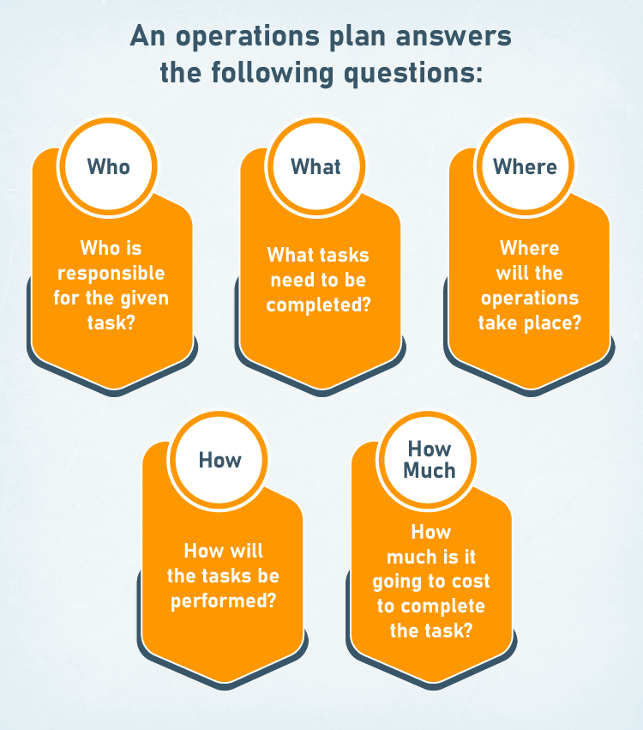
Continuation…
Some issues often addressed in an operational plan include:
Production or manufacturing
Maintenance and service - Order fulfilment and customer service
Facilities
Inventory
Distribution

Slide 26
MARKETING AND SALES
Outlines your plan for reaching and selling to your target market
The Marketing plan is a highly detailed, heavily researched and well written report (hopefully)
It is an essential document for both large corporate marketing departments and for start-up companies.
it determines how you'll plan on generating profit and describes how you intend to create exposure to best sell your product
Essentially the Marketing Plan:
Forces the marketing personnel to look internally in order to fully understand the results of past marketing decisions.
Forces the marketing personnel to look externally in order to fully understand the market in which they operate.
Sets future goals and provides direction for future marketing efforts that everyone within the organization should understand and support.

Slide 27
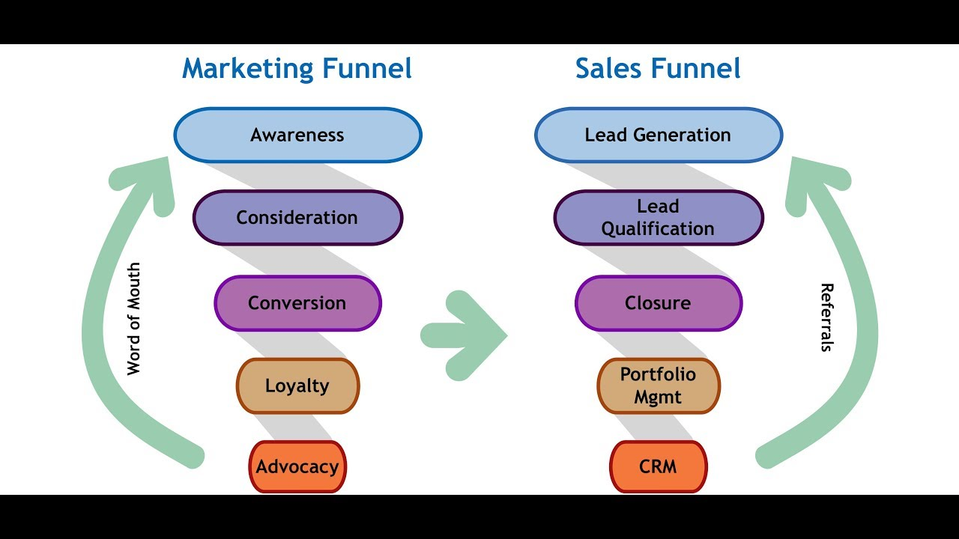
Continuation…
Marketing and Sales is key component for obtaining funding to pursue new initiatives.
There are many ways to develop and format a marketing plan. The approach taken here is to present a 6-Part plan that includes:
- Purpose and Mission
- Budgets, Performance Analysis
- Implementation
- Situational Analysis
- Marketing Strategy and Objectives
- Tactical Programs
- Additional Consideration

Slide 28
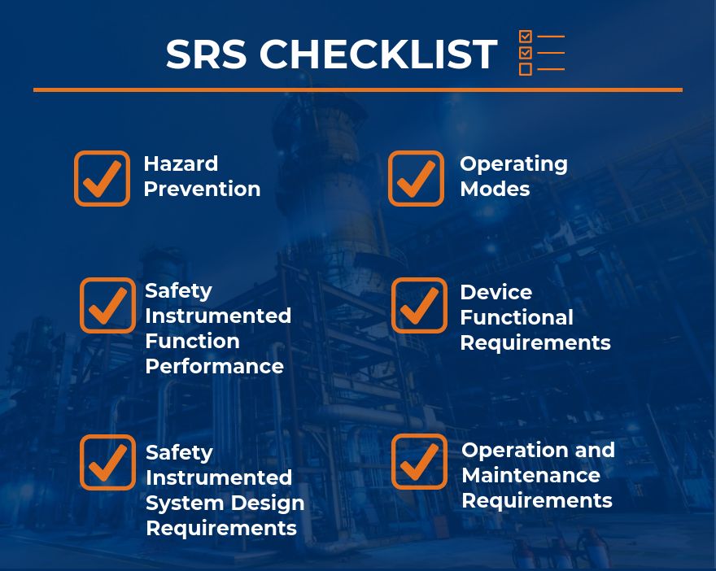
SAFETY REQUIREMENTS
The safety requirements are those requirements that are defined for the purpose of risk reduction, including a full list of identified risks, procedures for injuries and threats, including a plan for natural disasters, such as hurricanes, excessive heat and cold and flooding as well as risk prevention procedures, including risk awareness training for your managers and employees
To comply with health and safety regulations there's a range of key obligations you must fulfil:
  Report any accidents, injuries and near misses.
  Identify potential problem areas.
  Carry out regular risk assessments,
  Ensure safe storage
  handling and disposal of all hazardous substances, eg cleaning products, medicines and clinical waste.
  Control measures may need to be included in the risk assessment for individual clients
  Consider the increased risk that hazards may pose to vulnerable clients.

Slide 29
WAL-MART SWOT ANALYSIS EXAMPLE 1
Strengths - Wal-Mart is a powerful retail brand. It has a reputation for value for money, convenience and a wide range of products all in one store.
Weaknesses - Wal-Mart is the World's largest grocery retailer and control of its empire, despite its IT advantages, could leave it weak in some areas due to the huge span of control.
Opportunities - To take over, merge with, or form strategic alliances with other global retailers, focusing on specific markets such as Europe or the Greater China Region.
Threats - Being number one means that you are the target of competition, locally and globally.

Slide 30
BUSINESS PLAN STRUCTURE

Slide 31
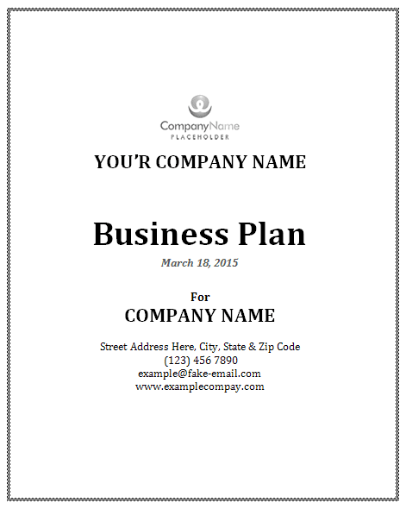
FRONT PAGE OF BUSINESS PLAN
Business Plan
Business Name
Business Address
Business Logo
Prepared By
Date

Slide 32

TABLE OF CONTENTS
A Table of Contents will act as an organized outline and navigational system for your business plan. It should be placed at the very beginning of the business plan so that your readers may quickly identify which sections apply to their specific interests and easily access them.
The table of contents introduces your new business to investors, suppliers and prospective business partners. It helps provide an overview of what readers can expect to read within the business plan.
Business Overview
Products/Services
Market Analysis
Competition
Marketing Strategy
Business Structure & Management
Finances
Action Plan
Appendices

Slide 33
BUSINESS OVERVIEW
The business overview is a component of a business plan that provides a general explanation of your company.
A business overview offers a snapshot of your business, such as company background, company’s products and services, the legal structure, the company’s mission statement and goals; how it operates, where it is based, how it makes money, etc.
Including:
how long itsbeen operating
the industry you’re in
point of difference over your competitors—such as different location, cheaper price or better service—and key benefits to your consumers
where the business will be in two-to-five years and how this will be achieved, e.g. your position financially and in the market place (you may need to complete this after you’ve worked through the other sections)

Slide 34
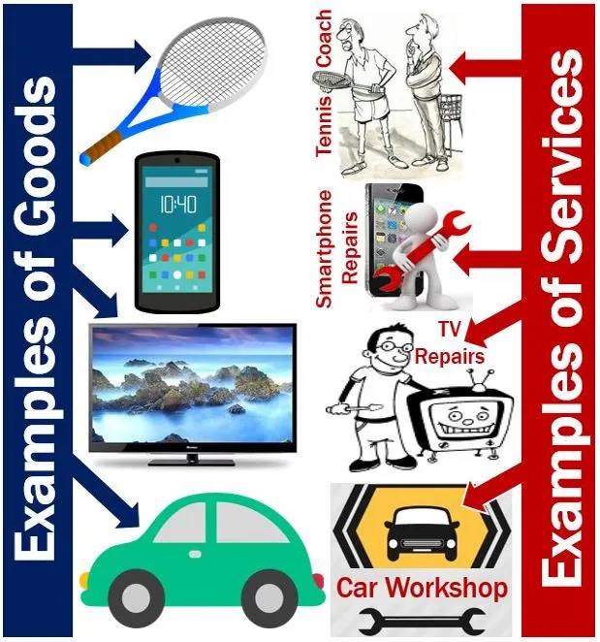
PRODUCTS/SERVICES
Describe what you are going to offer your customers, including:
Exactly what you are going to sell or provide and how it will be produced
Branding and packaging (where applicable)
On-going product or service development
Any dealings with supplier/s
Your product/service’s features and how they compare to major competitors
The price and how you have determined it (by considering production costs, labour and other overheads)

Slide 35
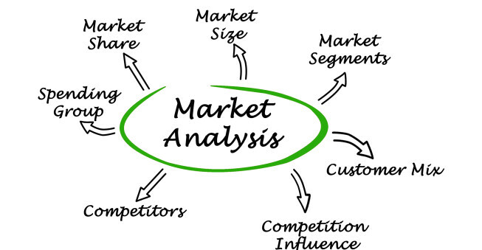
MARKET ANALYSIS
Market analysis is a thorough assessment of a market within a specific industry. With this analysis, you will study the dynamics of your market, such as volume and value, potential customer segments, buying patterns, competition, and other important factors.
You spend so much time on marketing related matters - customers, competitors, pricing, promotion and advertising -- that it is natural to assume you have little to learn.
Use the business planning process as your opportunity to uncover data and question your marketing efforts.

Slide 36

COMPETITION
The competition section is mainly there to reassure your target reader that you are aware of and understand the competition, and are positioned to take advantage of opportunities and avoid the pitfalls.
List details about your competitors including:
Who and where they are
How you'll position your product or service against them
Your product/service features against theirs and what gives you a competitive edge
The benefit/s of your service/product to the consumer
Comparison of your pricing, promotion and distribution

Slide 37
MARKETING STRATEGY
A marketing strategy refers to a business's overall game plan for reaching prospective consumers and turning them into customers of their products or services.
A marketing strategy contains the company's value proposition, key brand messaging, data on target customer demographics, and other high-level elements.
Show how consumers will find out about your product/service including:
Where, how and when you will promote your product/service such as shopping centre promotions, point of sale, viral marketing, billboards, loyalty schemes, etc
What type of printed materials you’ll create
Your website or online presence
Details and cost of advertising including print, online, tv and radio
Product/service launch plans
How you will measure the success of your marketing strategy and various promotions
How pricing will encourage sales (e.g. selling in bulk)

Slide 38
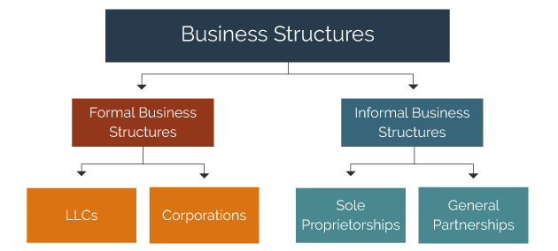
BUSINESS STRUCTURE & MANAGEMENT
Describe the ownership structure (such as sole trader, partnership, company) including:
Reasons for chosen structure
Any trademarks, patents, web addresses and other intellectual property you need to protect
Owners and any legal agreements you may need
Any key staff, their involvement, responsibilities and expected salaries
Your exit strategy

Slide 39
How to pitch your Business Plan

Slide 40
How to pitch your Business Plan
Creating a successful pitch starts with a thorough business plan.
The business pitch is different than the business plan. But you need to have your plan drafted before you can fine-tune your pitch.
A business pitch consists of an effort to convince others that your idea for a business is a good one
Pitching, or selling, your ideas to potential sponsors or clients involves proving how your company can deliver the products and services you say it can. Solidify what you plan to do, how you plan to do it and when you anticipate completing the activities before you schedule a presentation
Every entrepreneur has to present a business plan to outsiders at some point if he or she is seeking a loan or investment in the company.

Slide 41
How to pitch your Business Plan, Cont…
Additional elements to consider when pitching a business plan:
Create a presentation. ...
Practice your pitch. ...
Outline the problem with a story. ...
Your solution. ...
Your target market. ...
Your revenue or business model. ...
Your successes: Early traction and milestones. ...
Customer acquisition: Marketing and sales strategy.
Get to the point fast. ...
Don't use too many slides. ...
Establish the need. ...
Use a message map. ...
Use a multilevel structure to your pitch. ...
State who your competition is. ...
Include a sound bite. ...
Introduce the team

Slide 42
Finances in a Business Plan

Slide 43

FINANCIAL ANALYSIS
Financial Analysis refers to the assessment of a business to deal with the planning, budgeting, monitoring, forecasting, and improving of all financial details within an organization.
Financial Analysis assist in namely:
  Understanding your organization’s financial health is a fundamental aspect of responding to today’s increasingly stringent financial reporting requirements. To avoid risks, organizations must quickly
  Identify ascertain financial ratios and trends across liabilities and assets
  Analyse and adjust planned and forecasted amounts
  Act to provide regulatory statements as needed

Slide 44
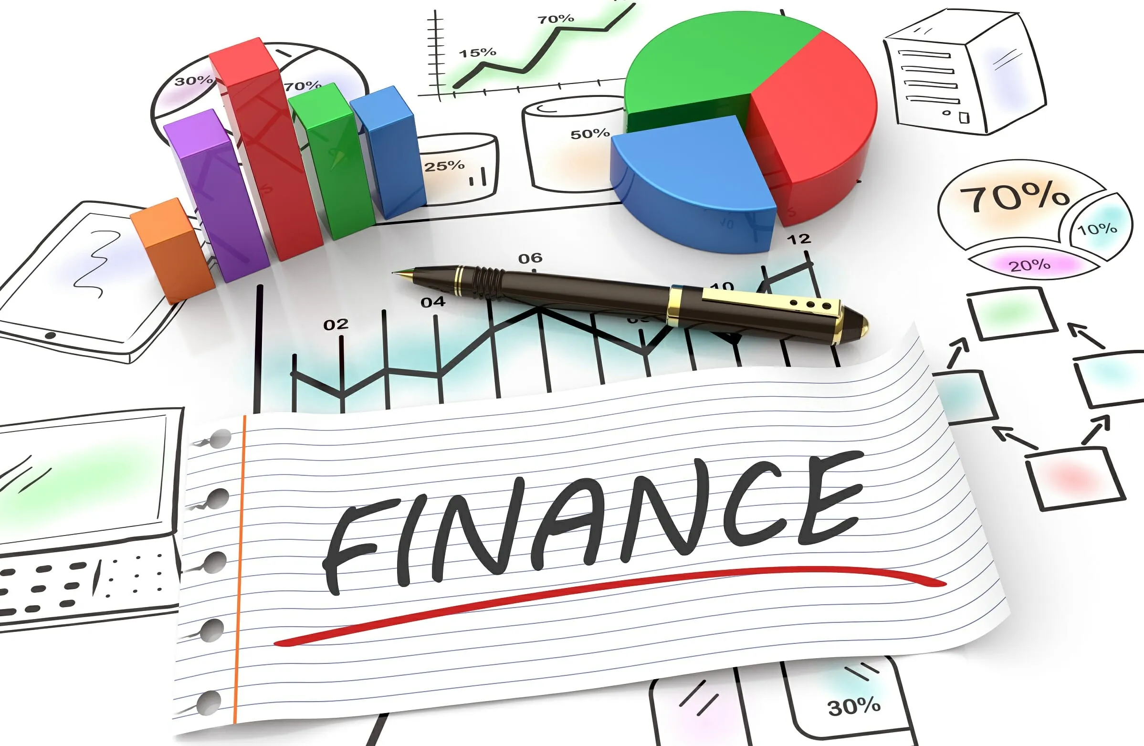
FINANCES
Summarise your financial situation including:
How you'll finance your business, e.g. business loan, personal funds, investment capital
costing, including your start-up costs, salary and fixed overheads
financial projections including how much you will need to make to break even, when you are likely to make a profit and growth expectations
Include the following:
Estimated Cost Sheet
Profit Loss Statement
Cash Flow Worksheet
Breakeven Analysis

Slide 45
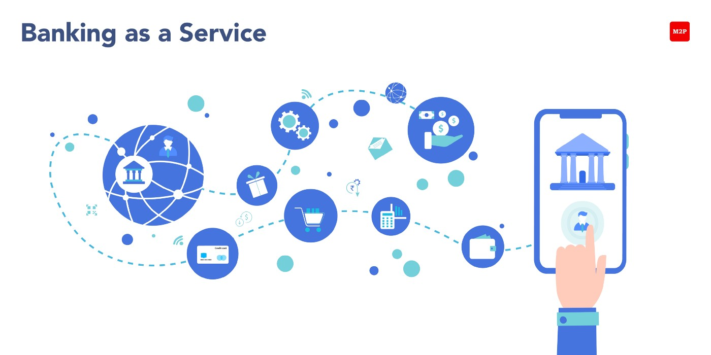
BANKING
Banking is the business of protecting money for others. Banks lend this money, generating interest that creates profits for the bank and its customers.
A bank is a financial institution licensed to accept deposits and make loans. But they may also perform other financial services.
Common Types of Banks
  Retail or Consumer Banks
  Credit Unions
  Savings and Loan Associations
  Commercial Banks
  Community Development Banks
  Investment Banks
  Online-Only Banks

Slide 46

LIST OF BANKS IN SOUTH AFRICA
Some of the registered banks Locally controlled:
ABSA Bank Limited
African Bank Limited
Bidvest Bank Limited
Capitec Bank Limited
FirstRand Bank Limited
Grindrod Bank Limited
Imperial Bank Limited
Investec Bank Limited
Nedbank Limited
Regal Treasury Private Bank Limited (In liquidation)
Sasfin Bank Limited
Teba Bank Limited
The Standard Bank of South Africa Limited

Slide 47
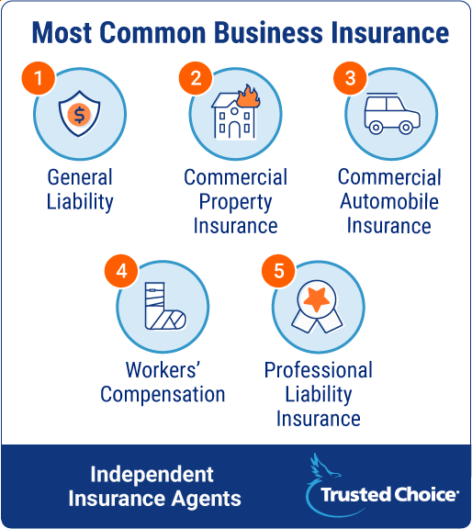
INSURANCE FOR BUSINESS
Whether for-profit or non-profit, small businesses should have certain kinds of insurance. Liability insurance is highly recommended for property and automobiles.
Worker's Compensation Insurance is state-required when you have employees.
Part of the decision about what insurance to buy depends on the nature of the business.
For example, if it has a lot of assets, it might consider theft and property damage insurance.

Slide 48
ACTION PLAN
List the key tasks to be done, by whom and by when, don’t make them too detailed or they become unworkable.
If you don’t achieve a task, reschedule it, but if it’s still not done by the second date, ask why. Is it too large? Is it unclear how it will help the business? Do we have the skills to do it?
See example below
Key Objectives | Task | By Whom | By When
Establishment
 | Register business and trademark | CP | 15 Dec
 | Research and purchase licences | FB | 15 Dec
Finalise premises | - Rental agreement - Redecorate - Finalise office set up | TS | 1 Feb

Slide 49
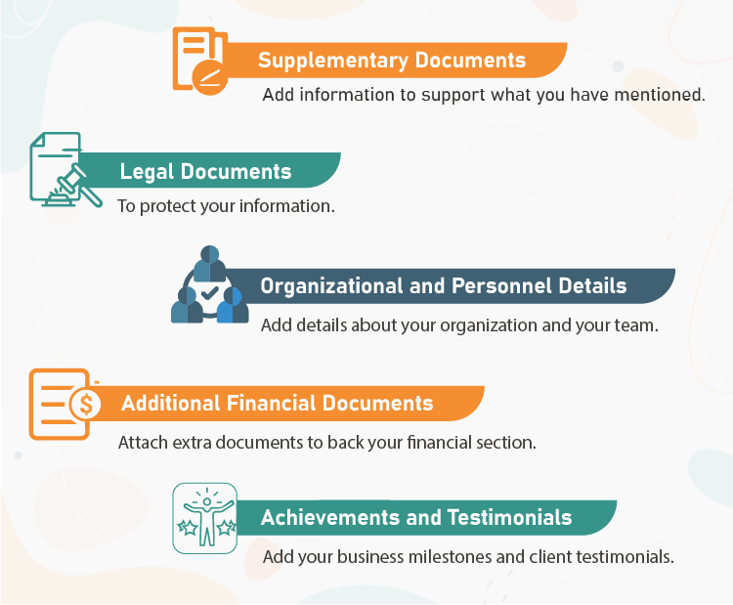
APPENDICES
The appendices are used to provide supporting documentation for key components in your business plan, such as financial statements or market research.
The appendix is also a great place to put any other tables or charts you didn't want to put in the main body of the business plan.

Slide 50

WHAT GOES IN THE APPENDIX OF A BUSINESS PLAN?
Supplementary information
Here, you can include additional information to support and expand whatever you have mentioned in other sections of your business plan. These will help the reader better understand the specifics of your company.
Charts, graphs, and tables
Marketing material
Market research
Competitor information
Illustrations of products
Property designs

Slide 51

Continuation…
Legal Documents
Business plan appendices usually include legal documents. These will protect your business and establish to your readers that you are trustworthy. You can include documents that are relevant or act as evidence of the information or claims present in your business plan.
Some of these legal documents are:
Incorporation papers
Licenses, permits, patents, and trademarks
Important contracts
Pending contracts
Leases and rental agreements
Vendor agreements
Equipment documentation

Slide 52
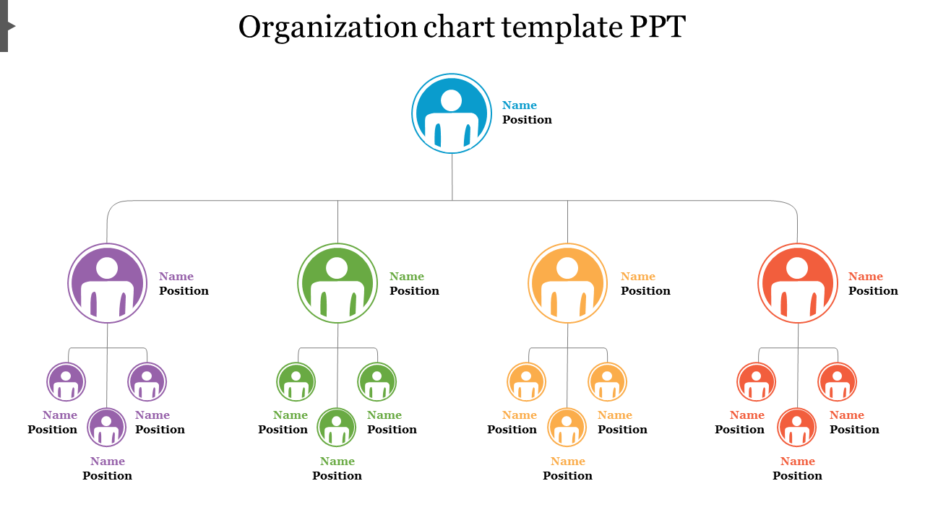
Continuation…
Organizational and Personnel Details
In the appendix section, you can also include your organizational process and details of the people involved in your company. These will let the reader have a peek into the workings of your company and the people behind it:
Organizational chart
Executive members’ resume
Affiliates such as attorneys, accountants, etc.

Slide 53
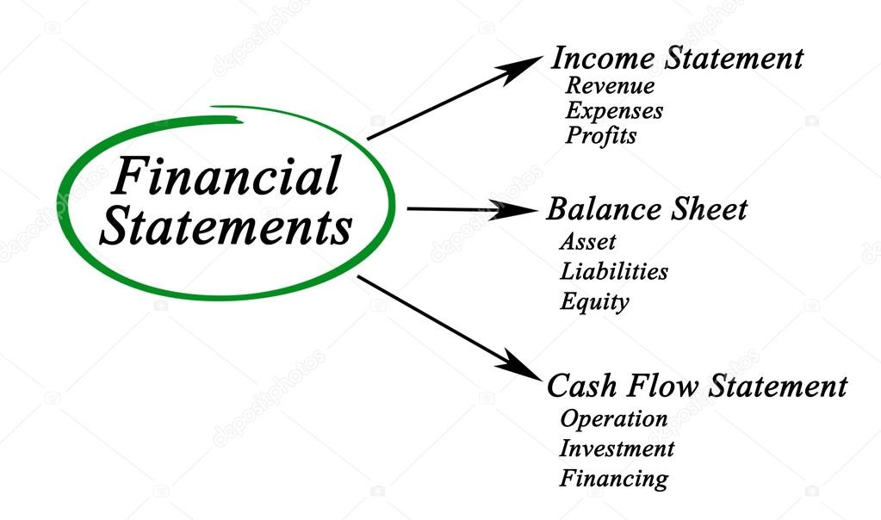
Continuation…
Additional Financial Documents
Your business plan already consists of ample financial information. But in case you need to attach any extra documents, you can include them in this section of your business plan. You may also need to include some exclusive documents for your investors and banks.
Some of them are:
List of assets within the business
Credit history
Tax returns
Spreadsheets of financial projections
Achievements, Testimonials, and News Stories
You can also include information that advocates your company’s credibility. This helps the reader to trust your products, and therefore, your brand too. Some of them are:
Media and press clippings
Customer or expert endorsements
Awards and achievements

Slide 54

Thank you .

